Slide 1

Feature Construction for Linear Methods
Notes:
1

Slide 2
Objectives
Describe Coarse Coding
Describe how Coarse coding relates to state aggregation
Understand how discrimination and generalization affects learning accuracy
Describe Tile Coding
Feature Construction for Linear Methods
2
Notes:
2

Slide 3
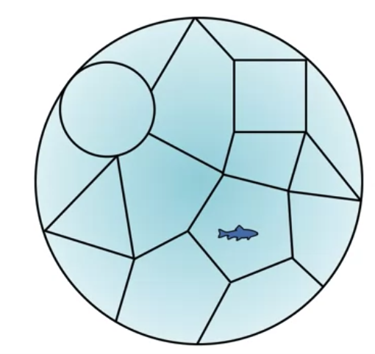
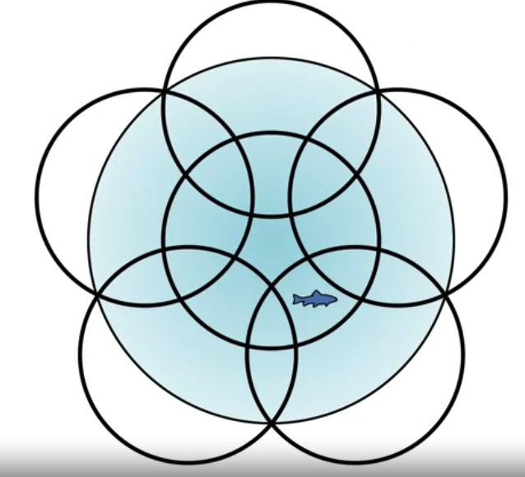
Coarse Coding
State aggregation does not usually allow the shapes to overlap.
By allowing overlap, we obtain a more flexible class of feature representations called course coding.
State aggregation
Coarse Coding
Feature Construction for Linear Methods
3
Notes:
3

Slide 4
Coarse Coding
Coarse coding provides an effective way to represent high-dimensional state spaces in reinforcement learning, allowing for efficient function approximation and learning in complex environments.
It strikes a balance between discretization and generalization, enabling agents to learn and make decisions effectively in large state spaces.
Feature Construction for Linear Methods
4
Notes:
4

Slide 5
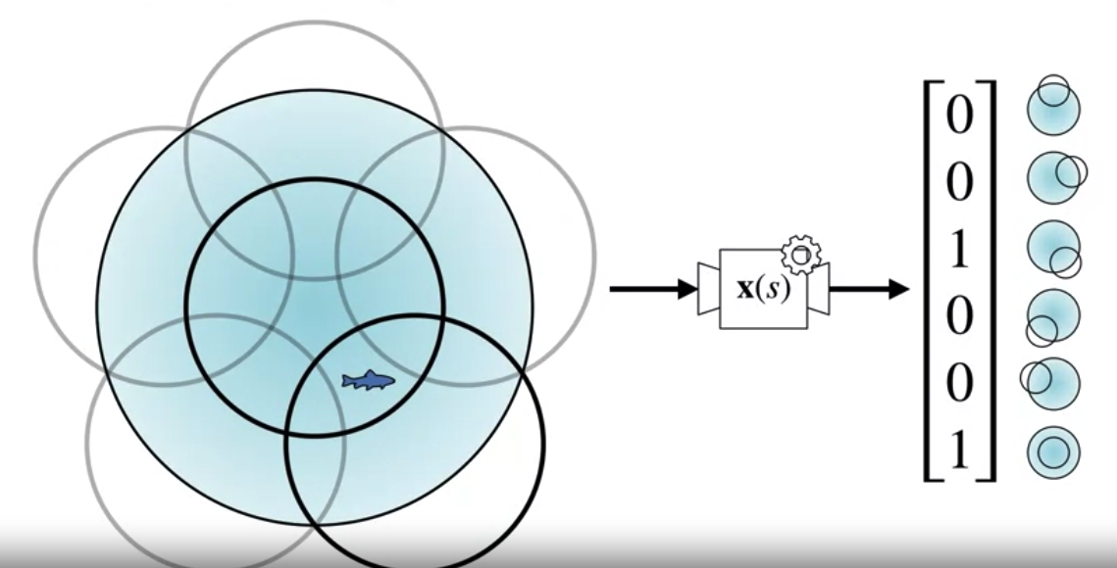
Coarse Coding
The example feature vector for the fishes current location in the pond.
Each index in the feature vector corresponds to one of the shapes.
The feature corresponding to the circle is active or set to 1 if the fish is within that circle, otherwise the feature set to 0.
Feature Construction for Linear Methods
5
Notes:
5

Slide 6
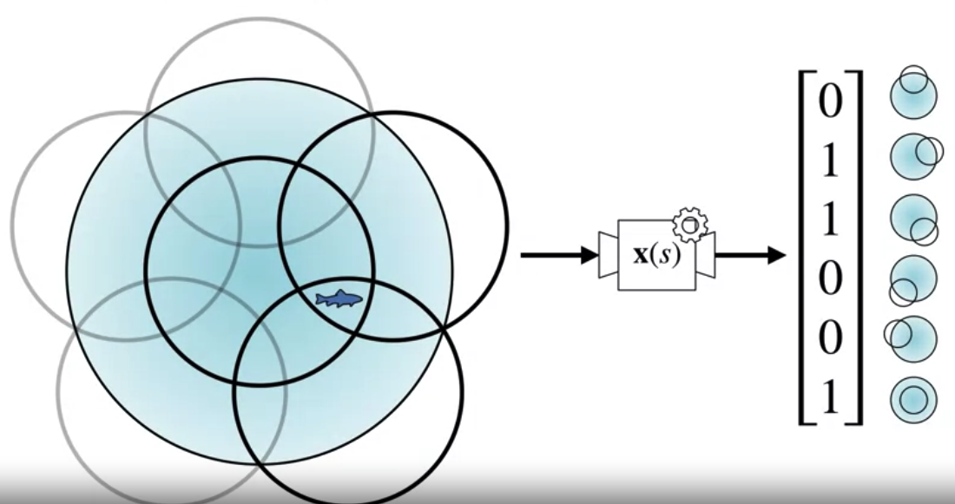
Coarse Coding
The example, the fishes current location in the pond.
The features receptive field corresponds to the locations that activate that feature.
When the fish moves to a new location, it's usually covered by a different set of circles.
Nearby states will have similar feature activations, but they may also have different components active including different numbers of active features.
6
Notes:
6

Slide 7
Discrimination and Generalization
They important roles in learning accuracy, and finding the right balance
Discrimination helps capture fine-grained distinctions in the data.
Generalization ensures that the model can make accurate predictions or decisions in diverse and unseen situations.
Feature Construction for Linear Methods
7
Notes:
7

Slide 8
Discrimination affect Learning Accuracy
Definition:
Discrimination refers to the ability of a learning algorithm to distinguish between different classes or states in the training data.
It involves learning fine-grained distinctions and capturing specific patterns or features unique to each class or state.
Feature Construction for Linear Methods
8
Notes:
8

Slide 9
Discrimination affect Learning Accuracy
Effect on Learning Accuracy:
Discrimination can improve learning accuracy in situations where fine-grained distinctions are crucial for making accurate predictions or decisions.
Discriminatory models can achieve high accuracy on tasks that require precise classification or prediction.
Feature Construction for Linear Methods
9
Notes:
9

Slide 10
Discrimination affect Learning Accuracy
Risk of Overfitting:
However, excessive discrimination can lead to overfitting, where the model memorizes noise or irrelevant details in the training data, resulting in poor generalization performance on unseen data.
This can reduce overall learning accuracy, especially in noisy or complex environments.
Feature Construction for Linear Methods
10
Notes:
10

Slide 11
Generalization affect Learning Accuracy
Definition:
Generalization refers to the ability of a learning algorithm to perform well on unseen data or in new situations beyond the training data.
It involves capturing underlying patterns and relationships in the data that are consistent across different instances or contexts.
Feature Construction for Linear Methods
11
Notes:
11

Slide 12
Generalization affect Learning Accuracy
Effect on Learning Accuracy:
Generalization is essential for achieving high learning accuracy in real-world applications.
Models that generalize well can effectively capture the underlying structure of the data and make reliable predictions even in novel situations.
Feature Construction for Linear Methods
12
Notes:
12

Slide 13
Generalization affect Learning Accuracy
Risk of Underfitting:
Excessive generalization can lead to underfitting, where the model fails to capture important patterns or variations in the data, resulting in poor performance even on the training data.
This can also reduce learning accuracy, especially if the model oversimplifies the underlying relationships in the data.
Feature Construction for Linear Methods
13
Notes:
13

Slide 14
Tile Coding
It is a technique used in reinforcement learning and function approximation to represent high-dimensional state spaces more efficiently.
It involves dividing the continuous state space into a set of overlapping tiles or regions and encoding the presence or absence of the state within each tile.
Feature Construction for Linear Methods
14
Notes:
14

Slide 15
Tile Coding
Tile Partitioning:
The continuous state space is divided into a set of non-overlapping tiles or regions. These tiles collectively cover the entire state space, and each state falls within one or more tiles.
Encoding Scheme:
Each tile is assigned a unique identifier or code, which is used to represent the presence or absence of the state within that tile
Feature Construction for Linear Methods
15
Notes:
15

Slide 16
Tile Coding
Overlapping Tiles:
To capture correlations and interactions between adjacent states, tiles are typically allowed to overlap.
Feature Vector Representation:
The state is represented as a feature vector, where each element of the vector corresponds to a tile or region in the tile coding scheme.
Feature Construction for Linear Methods
16
Notes:
16

Slide 17
Tile Coding
Efficient Function Approximation:
Tile coding allows for efficient function approximation using simple linear models or neural networks.
Instead of directly approximating the value function or policy over the continuous state space, the function approximator learns to predict values or policies based on the tile-coded feature vector representation of states.
Feature Construction for Linear Methods
17
Notes:
17

Slide 18
Tile Coding
Generalization and Compression:
Despite the coarse granularity of the tiles, tile coding enables generalization across similar states within each tile.
By representing multiple similar states with the same tile-coded feature vector, tile coding achieves compression of the state space while preserving important state information.
Feature Construction for Linear Methods
18
Notes:
18

Slide 19
Tile Coding
Training and Learning:
Tile-coded feature vectors are used as input to the function approximator, which is trained using reinforcement learning algorithms such as TD learning, Q-learning, or policy gradient methods.
The function approximator learns to associate each tile-coded state representation with its corresponding value or policy.
Feature Construction for Linear Methods
19
Notes:
19

Slide 20
Using Tile Coding in TD
Using tile coding in TD learning involves leveraging tile-coded feature representations of states to estimate value functions or policies more efficiently.
Agents can efficiently learn value functions or policies in high-dimensional state spaces, achieving a balance between granularity and generalization while effectively representing the environment's dynamics.
Feature Construction for Linear Methods
20
Notes:
20

Slide 21
Using Tile Coding in TD
This approach is particularly useful in real-world reinforcement learning tasks with complex and continuous state spaces.
Feature Construction for Linear Methods
21
Notes:
21

Slide 22
Summary
Describe Coarse Coding
Describe how Coarse coding relates to state aggregation
Understand how discrimination and generalization affects learning accuracy
Describe Tile Coding
Feature Construction for Linear Methods
22

Slide 23
Q & A
Feature Construction for Linear Methods
23

